Slide 1
Control Statements in Java
Flow control statements in Java are those statements that change the flow of execution and provide better control to the programmer on the flow of execution in the program.
These statements are executed randomly and repeatedly. Control statements in Java programming are used to write better and complex programs.

Slide 2
Control Statements in Java
Java supports two kinds of control flow statements:
Conditional statements
Unconditional statements

Slide 3
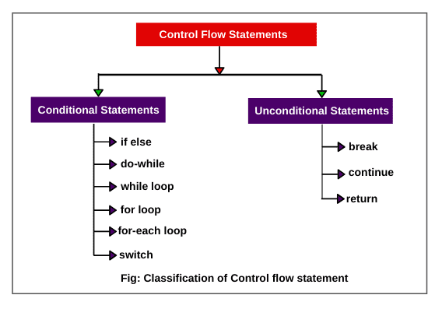
Control Statements in Java

Slide 4
If Statement in Java
An if statement in Java is the simplest decision-making statement that allows to specify alternative paths of execution in a program. It is also called a conditional control statement or selection statement in Java.
// Syntax:
if(Condition)
statement; // statement to be executed if the condition is true.
or,
if(Condition)
{
statements; // statements to be executed if the condition is true.
}

Slide 5
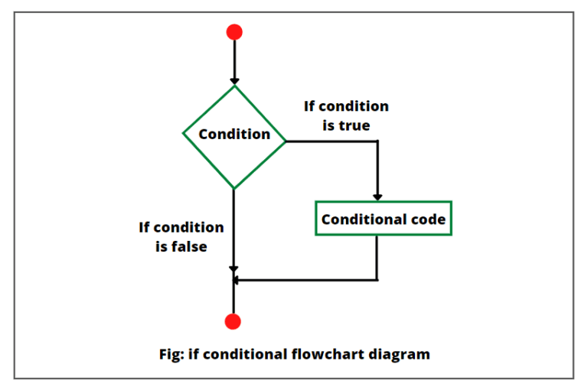
If Statement in Java

Slide 6
If else in Java | Nested if else
A two-way if else statement in Java routes program execution through two different paths based on whether the condition is true or false.
Syntax:
if(boolean expression or condition) {
statement1; // statement to be executed if the condition is true.
}
else {
statement2; // statement to be executed if the condition is false.
}

Slide 7
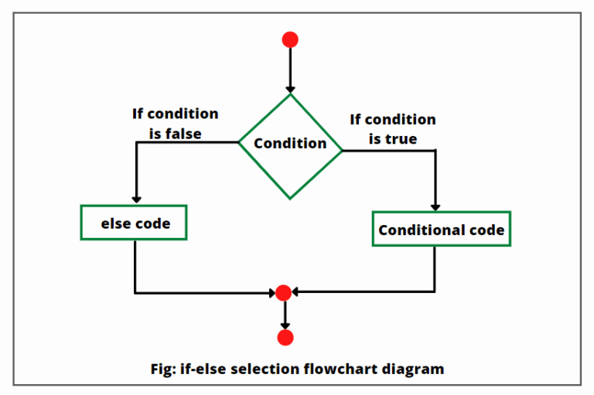
If else in Java | Nested if else

Slide 8
If else If Ladder Statements in Java
The if else if ladder in Java is a multi-way decision structure that is used to decide among three or more actions.
The general syntax:
if(condition)
statement1;
else if(condition)
statement2;
else if(condition)
statement3;
...
else
statement4;

Slide 9
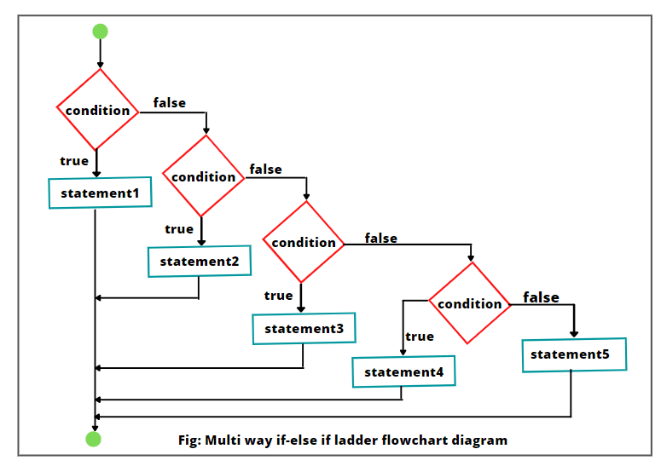
If else If Ladder Statements in Java

Slide 10
Loops in Java | Types
Loops in Java are the processes that execute a block of statements repeatedly until a termination condition is met.
In other words, loops are a fundamental programming construct in which a part of the program is repeated over and over until a specific goal is reached.

Slide 11
Types of Loop (Iteration) Statements in Java
Java language provides three types of loop statements for performing loop operations. They are:
while loop
do-while loop
for loop

Slide 12
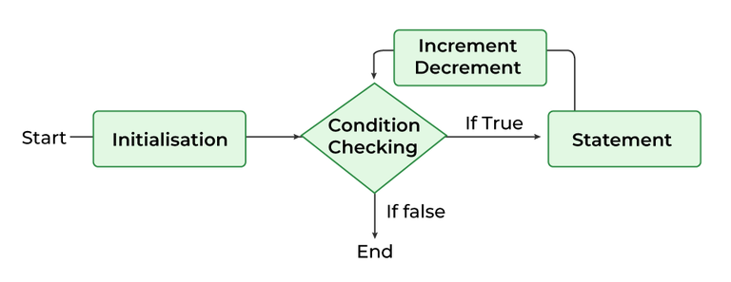
For Loop in Java | Syntax
The for loop in Java is an entry-controlled loop structure that executes a set of statements a fixed number of times.
It is perfect for those scenarios where we know the exact number of iterations needed to accomplish a task.
Syntax of For Loop in Java
for(initialization; test-condition; iteration (increment/decrement)) {
// Loop body
Statement(s); // statements to be executed.
}
Or,
for (i = initialValue; i < endValue; i++) {
Statement(s);
}

Slide 13
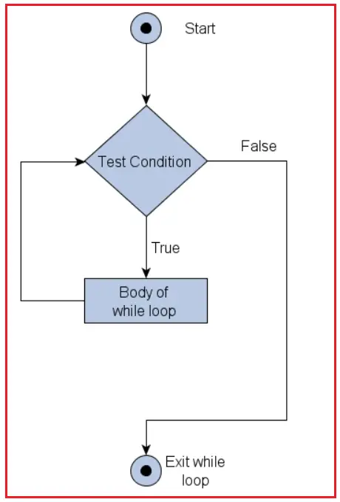
While Loop in Java
A while loop repeats the body of the loop as long as the loop condition holds. Each repetition of the body of loop is called iteration.
Syntax of While Loop in Java:
Initialization;
while(test condition)
{
// Loop body
Statement(s);
Increment/Decrement;
}

Slide 14
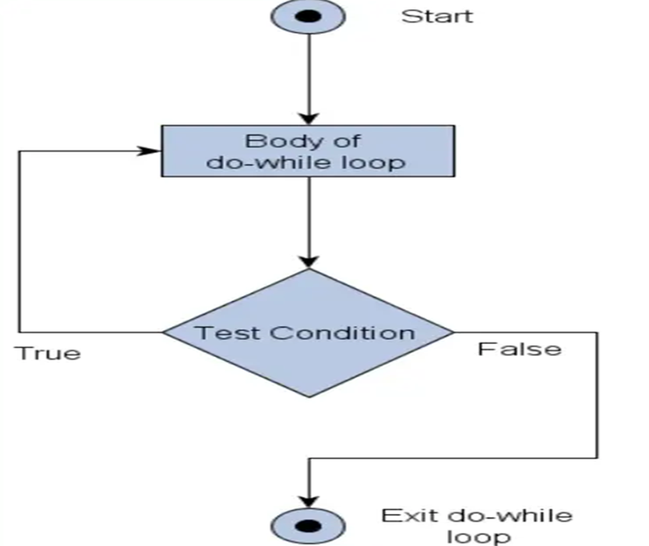
Do While Loop in Java
In the while loop statement, the test condition evaluates first before the loop body executes. If the condition is initially false, the body of loop will not execute at all and the control of execution will proceed to the next set of statements to execute.
Syntax of Do While Loop in Java:
Initialization;
do {
Statement(s);
Increment / decrement;
} while (test conditional expression);

Slide 15
Switch Statement in Java
A switch statement in Java is a conditional control statement (or multi-way decision statement) that executes one statement from multiple conditions.
It uses the result of an expression to evaluate which statements to execute. It is an alternative to if-else-if ladder statement.
In other words, a switch statement executes statements based on the value of a variable or an expression, against a list of case values.
If a match is found, a block of statements corresponding to that case is executed.

Slide 16
Syntax to Switch Statement in Java
switch(integer expression)
{
case value-1:
// statement sequence
break;
case value-2:
// statement sequence
break;
. . . . .
case value-n:
// statement sequence
break;
default:
// default statement sequence
}
statement-x;

